Slide 1
Influence of Top MNCs on Graduates in Education
Submitted to :-
Dr. Gaurav Bathla
(E2593)
Submitted by :-
Anurag Yadav (24MCS10043)
Masters of Engineering - CSE

Slide 2
Contents
Introduction
Problem Statement
Relevance to Theme
Literature Review
Proposed Solution
Feasibility Analysis
Benefits
Project Timeline
Conclusion
References

Slide 3
Introduction
Context:
The emergence of MNCs offering lucrative salaries has become a defining trend in the last decade.
India, as a hub of engineering talent, sees a disproportionate number of students pursuing BTech and MTech degrees.
Students often pursue degrees not based on passion or skill but on the potential to secure top-tier salaries.
Facts and Data
"In 2024, the highest salary offered in India was ₹4.2 crore at Google, while average salaries at top MNCs exceeded ₹40 LPA."
(Source: Placement records, IIT Bombay, and Levels.fyi).
"In 2023, over 75% of students in India pursuing higher education opted for engineering, IT, or management programs."
(Source: UGC Annual Report).

Slide 4
Problem Statement
Main Problems:
Career Choices Driven by Salary:
Students view education as a direct pathway to high-paying MNC roles, leading to skewed career aspirations.
For example, fields like humanities, social sciences, and core sciences are being overshadowed by tech-centric programs.
Impact on Higher Education:
Institutions are aggressively introducing new tech courses to attract students and match industry trends.
Non-tech departments often experience budget cuts and reduced resources, resulting in fewer opportunities for research and innovation.
National Workforce Imbalance:
Over-saturation in tech-related fields, and neglect of critical fields like agriculture, environment, and healthcare could hamper long-term societal progress.

Slide 5
Relevance to Theme
Why This Research Matters:
Identifies the socio-economic impact of salary-driven academic trends.
Explores how educational systems and career landscapes adapt to market needs.
Broader Implications:
Workforce imbalance: The oversupply of engineers vs. the underrepresentation of professionals in other fields.
Stifling innovation in fields beyond technology.
Real-World Examples:
IITs have introduced specialized tech courses (e.g., AI, Data Science) while arts and design departments remain underfunded.

Slide 6
Literature Review
Research by AICTE (2022) showed a significant increase in the number of courses and resources dedicated to AI, machine learning, and data science.
Between 2015 and 2022, the number of universities offering AI programs tripled, while funding for arts and humanities fell by 25%
Implication: Institutions are prioritizing tech-driven programs to attract recruiters from top MNCs.
A report by McKinsey Global Institute (2020) highlighted that students’ career decisions in India are influenced more by salary potential than by personal aptitude or interest.
This "salary race" has led to increased stress, reduced job satisfaction, and misaligned skill sets in the workforce.

Slide 7
Literature Review
Findings from the UGC Annual Report (2023) show that while enrollment in engineering courses increased by 40% from 2010 to 2023, programs in basic sciences and the arts saw only a 5% increase.
Gaps in Existing Research:
Lack of comprehensive data on how these trends affect graduates' career satisfaction.
Limited exploration of long-term consequences for non-tech fields.

Slide 8
Proposed Solution
Data Collection:
Primary Sources:
Placement records of leading Indian universities (IITs, NITs, state universities).
Salary reports from platforms like Levels.fyi and Glassdoor.
Secondary Sources:
Published studies, annual reports from UGC and AICTE, industry whitepapers, and job market trends.
Data Analysis:
Use Python libraries (e.g., Pandas, Matplotlib, Seaborn) to analyze trends in:
Salary distributions across various degrees.
Enrollment patterns in different disciplines.
Apply statistical tools to measure correlations between high salaries and shifts in student preferences.

Slide 9
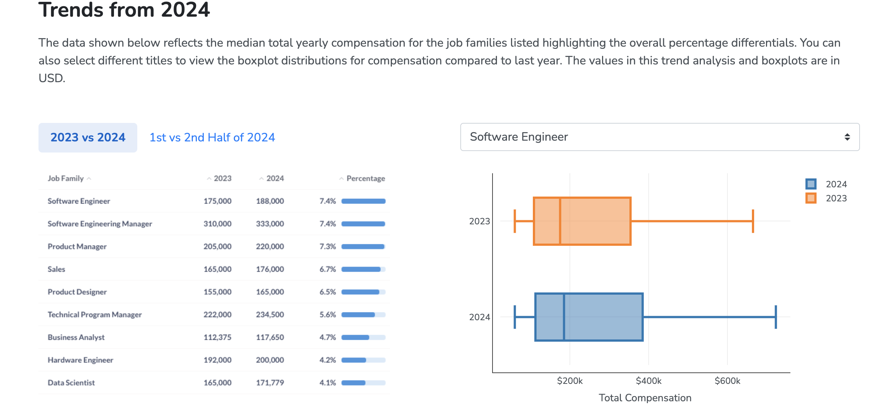
Proposed Solution
Outcomes of the Solution:
A deeper understanding of how salary trends shape educational priorities.
Actionable insights for universities to design balanced curricula.
Long-term strategies for creating a diverse and sustainable workforce in India.

Slide 10
Feasibility Analysis
Data Sources:
Salary data: Levels.fyi, Glassdoor, company reports.
Placement records: Publicly available data from institutions like IITs, NITs, and private universities.
Tools and Technology:
Python for data analysis (Pandas, Matplotlib).
Survey tools like Google Forms for qualitative data.
Statistical methods to validate trends.
Challenges:
Limited transparency in placement data for private universities.
Potential bias in self-reported student data.

Slide 11
Benefits
For Students:
Informed career choices based on a blend of passion, skills, and market demand.
Reduced societal and peer pressure to pursue only high-paying tech roles.
For Educational Institutions:
Opportunity to innovate in underrepresented fields like environmental sciences, social sciences, and design.
For Policy Makers:
Insights for creating balanced educational reforms.

Slide 12
Project Timeline
Phase | Timeline | Tasks
Literature review | Week 1-2 | Review papers and identify gaps.
Data collection and preprocessing | Week 3-4 | Salary trends, placement records.
Data Cleaning & Analysis | Week 4-6 | Filtering outliers, data visualization.
Model development and testing | Week 7-9 | Build, train, and evaluate models.
Results analysis and documentation | Week 10-12 | Analyze trends and prepare report.

Slide 13
Conclusion
The research aims to shed light on the profound impact that top MNC salary packages have on the educational and career choices of Indian graduates. The allure of high-paying roles in technology-driven sectors has significantly shaped student aspirations, leading to a disproportionate focus on degrees like BTech and MTech. This trend has, in turn, influenced educational institutions to tailor their curricula predominantly toward these fields, often at the expense of other critical disciplines such as core sciences, humanities, and environmental studies. While these shifts align with the growing demands of the global job market, they also risk creating an imbalanced workforce and neglecting sectors essential for holistic societal development. By analyzing salary trends, institutional placement records, and student preferences, this study seeks to provide actionable insights for fostering a more inclusive and diverse academic ecosystem.

Slide 14
References
[1] Levels.fyi:www.levels.fyi
[2] Economic Times: https://economictimes.indiatimes.com
[3] Placement Reports: IIT Bombay, NIT Trichy, VIT University.
[4] AICTE Journals: Curriculum Reforms for Emerging Technologies.
[5] Government of India, UGC Reports: Enrollment Data by Discipline.

Slide 15
THANKS

